Slide 1
數位系統導論11
Sequential Logic Design by VHDL
陳慶瀚
國立中央大學資工系
2017年5月3日

Slide 2
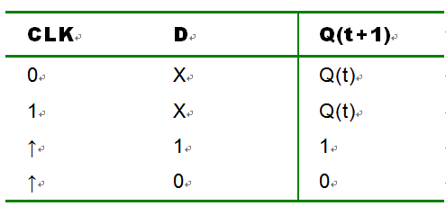
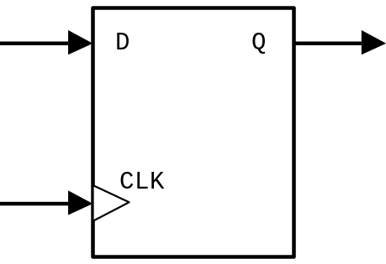
D型正反器的設計

Slide 3
D型正反器的設計
LIBRARY IEEE;
USE IEEE.STD_LOGIC_1164.ALL;
ENTITY dff_v is
PORT( CLK,D : IN STD_LOGIC;
Q : OUT STD_LOGIC );
END dff_v;
ARCHITECTURE a OF dff_v IS
BEGIN
PROCESS (CLK)
BEGIN
IF CLK'event AND CLK='1' THEN --當CLK發生正緣觸發時(由0–>1變化瞬間)
Q <= D;
END IF;
END PROCESS;
END a;

Slide 4
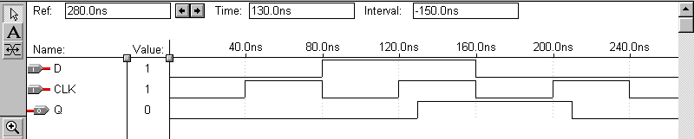
D型正反器的設計

Slide 5
具有set和reset功能的D型正反器
LIBRARY IEEE;
USE IEEE.STD_LOGIC_1164.ALL;
ENTITY dff_v1 is
PORT( CLK,D,set,reset : IN STD_LOGIC;
Q : OUT STD_LOGIC );
END dff_v1;
ARCHITECTURE a OF dff_v1 IS
BEGIN
PROCESS (CLK)
begin
if set = '1' then q<='1';
elsif reset='1' then q<='0';
elsif CLK'event AND CLK='1' THEN
Q <= D;
end if;
END PROCESS;
END a;

Slide 6
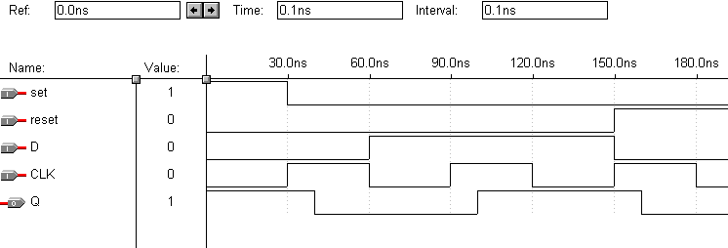
具有set和reset功能的D型正反器

Slide 7
具有enable功能的D型正反器
LIBRARY IEEE;
USE IEEE.STD_LOGIC_1164.ALL;
ENTITY DFF IS
PORT( CLK,D,set,reset,EN : IN STD_LOGIC;
Q : OUT STD_LOGIC );
END DFF;
ARCHITECTURE a OF DFF IS
BEGIN
PROCESS (CLK)
BEGIN
IF set='1' then Q<='1';
elsif reset='1' then Q<='0';
elsif CLK'event AND CLK='1' then
IF EN ='1' THEN
Q <= D;
END IF;
END IF;
END PROCESS;
END a;

Slide 8
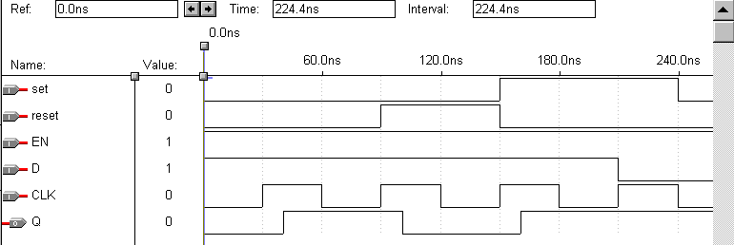
具有enable功能的D型正反器

Slide 9
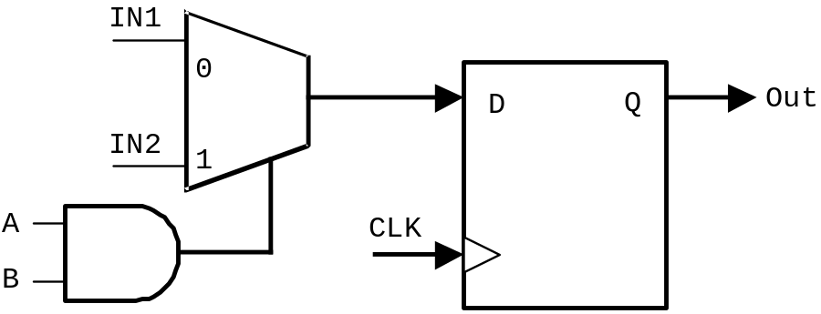
Sequential Circuit設計範例
IF CLK'event AND CLK='1' THEN
IF (A=’1’ and B=’1’) THEN
Out<=IN2;
ELSE
Out<=IN1;
END IF;
END IF;

Slide 10
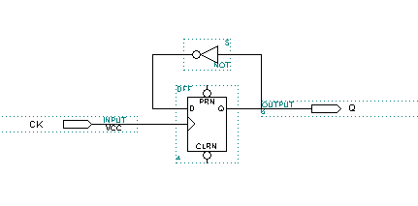
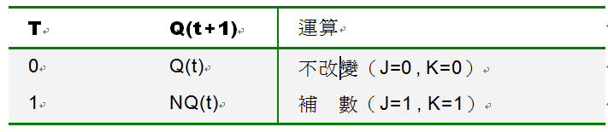
T型正反器與除頻電路

Slide 11
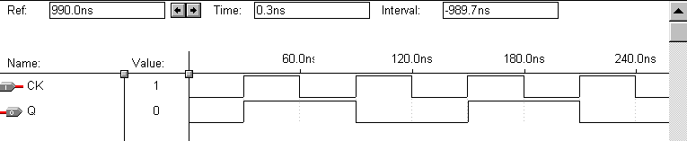
T型正反器與除頻電路

Slide 12
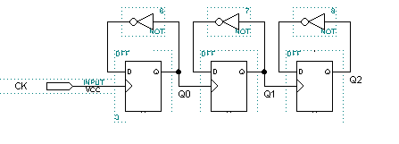
除8電路

Slide 13
除8電路
ARCHITECTURE a OF div IS
signal Q0,Q1,Q2:STD_LOGIC;
BEGIN
PROCESS (CLK,Q0,Q1)
begin
if CLK'event AND CLK='1' then Q0<=not Q0;
end if;
if Q0'event AND Q0='1' then Q1<=not Q1;
end if;
if Q1'event AND Q1='1' then Q2<=not Q2;
end if;
END PROCESS;
Q<=Q2;
END a;

Slide 14
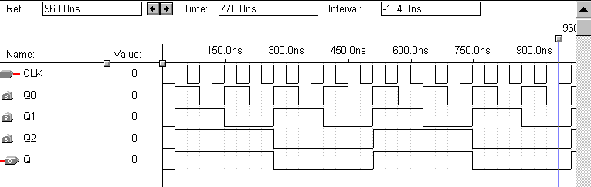
除8電路

Slide 15
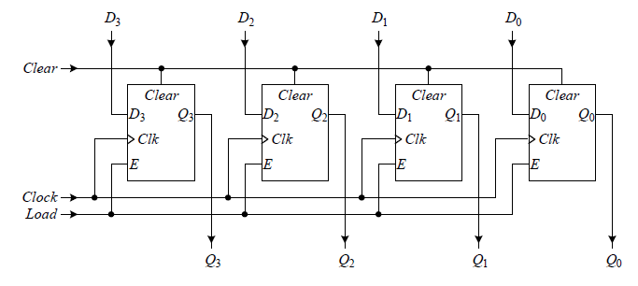
Register
4-bit register with active high Load and Clear signals

Slide 16
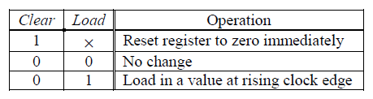
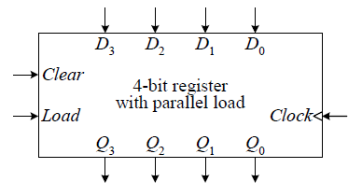
4-bit Register

Slide 17
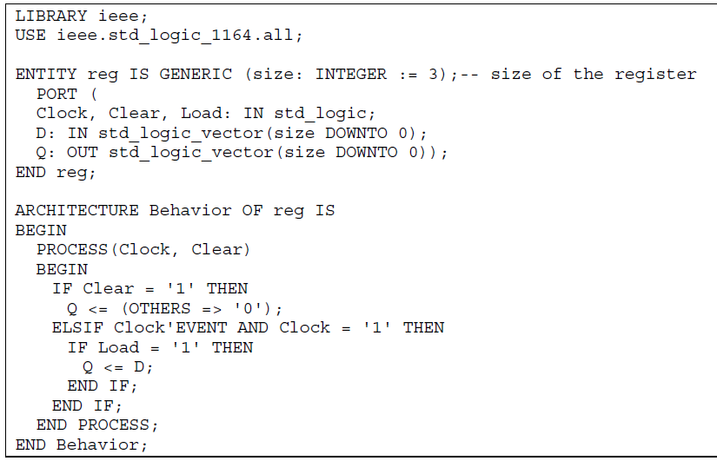
4-bit Register

Slide 18
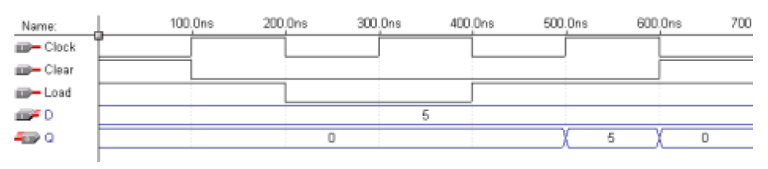
4-bit Register

Slide 19
Counter
Modulo-n counter:
Counts from decimal 0 to n-1 and back to 0. For example, a modulo-5 counter sequence in decimal is 0, 1, 2, 3, and 4.
Binary Coded Decimal (BCD) counter:
Just like a modulo-n counter except that n is fixed at 10.
n-bit binary counter:
Similar to modulo-n counter but the range is from 0 to 2n-1 and back to 0, where n is the number of bits used in the counter.
Gray-code counter:
The sequence is coded so that any two consecutive values must differ in only one bit.
Ring counter:
The sequence starts with a string of 0 bits followed by one 1 bit, as in 0001. This counter simply rotates the bits to the left on each count. For example, 0001, 0010, 0100,1000, and back to 0001.

Slide 20

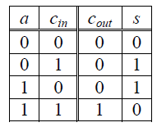
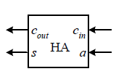

Counter
An n-bit binary counter can be constructed using a modified n-bit register where the data inputs for the register come from an incrementer (adder) for an up counter, and a decrementer (subtractor) for a down counter.

Slide 21
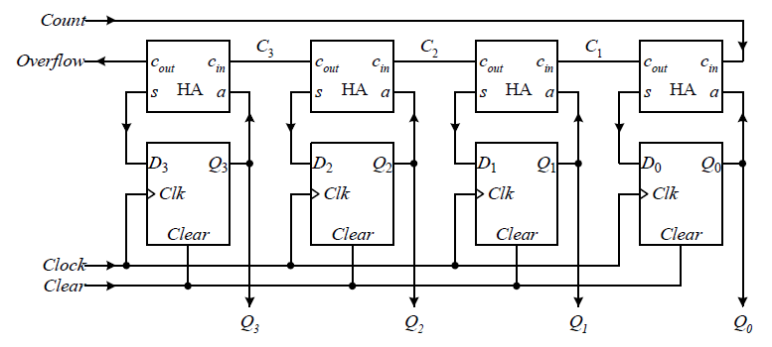
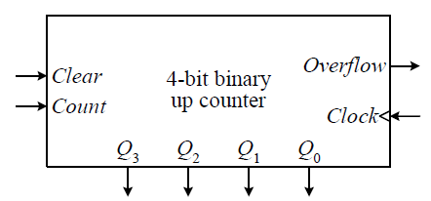
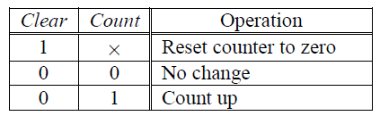
Counter

Slide 22
LIBRARY IEEE;
USE IEEE.STD_LOGIC_1164.ALL;
USE IEEE.STD_LOGIC_UNSIGNED.ALL; -- need this to add STD_LOGIC_VECTORs
ENTITY counter IS PORT (
Clock: IN STD_LOGIC;
Clear: IN STD_LOGIC;
Count: IN STD_LOGIC;
Q : OUT STD_LOGIC_VECTOR(3 DOWNTO 0));
END counter;
ARCHITECTURE Behavioral OF counter IS
SIGNAL value: STD_LOGIC_VECTOR(3 DOWNTO 0);
BEGIN
PROCESS (Clock, Clear)
BEGIN
IF Clear = '1' THEN
value <= (OTHERS => '0'); -- 4-bit vector of 0, same as "0000"
ELSIF (Clock'EVENT AND Clock='1') THEN
IF Count = '1' THEN
value <= value + 1;
END IF;
END IF;
END PROCESS;
Q <= value;
END Behavioral;

Slide 23

Counter

Slide 24
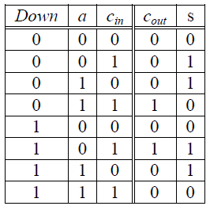
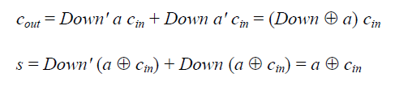
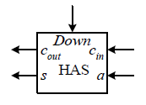
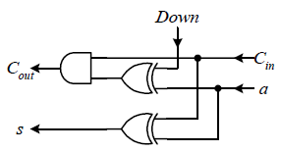
Up-Down Counter

Slide 25
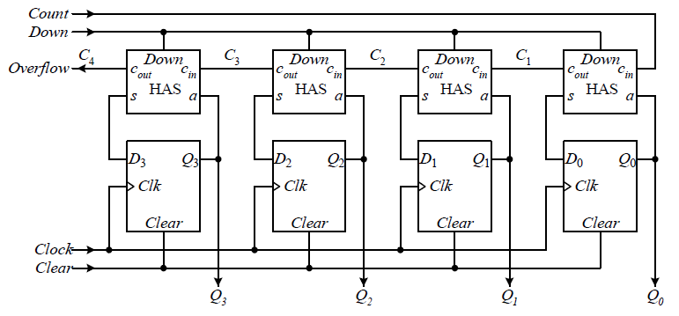
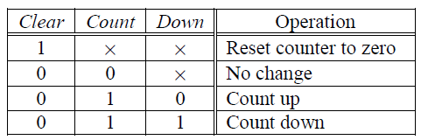
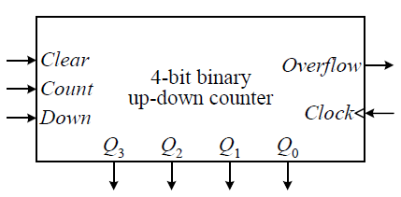
Up-Down Counter

Slide 26
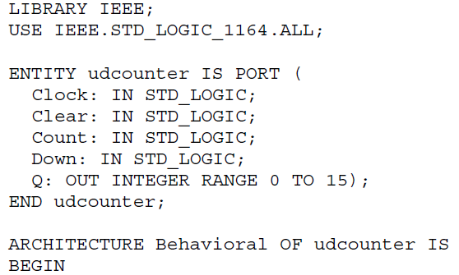
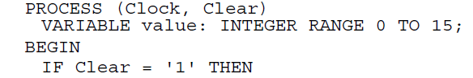
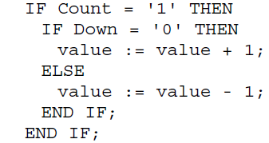
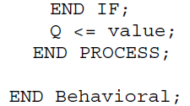
Up-Down Counter

Slide 27
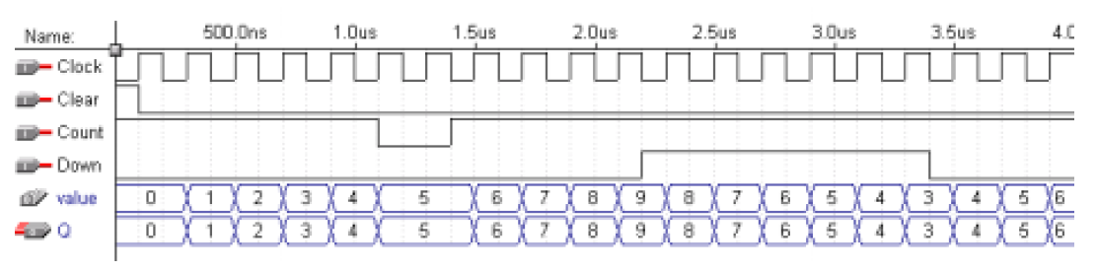
Up-Down Counter

Slide 28
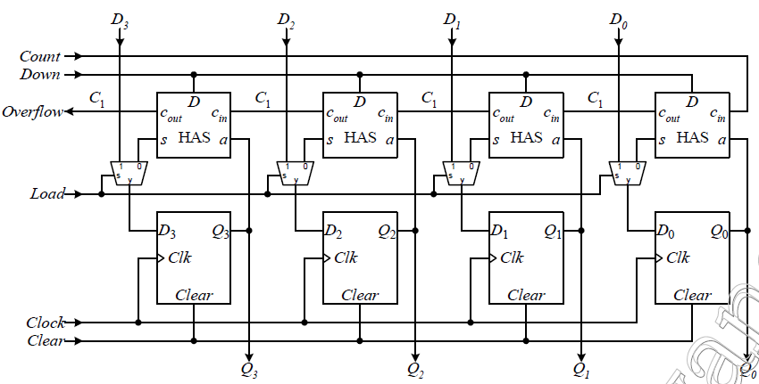
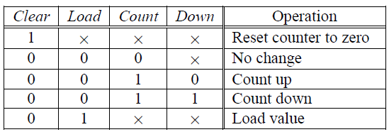
Up-Down Counter with Parallel Load

Slide 29
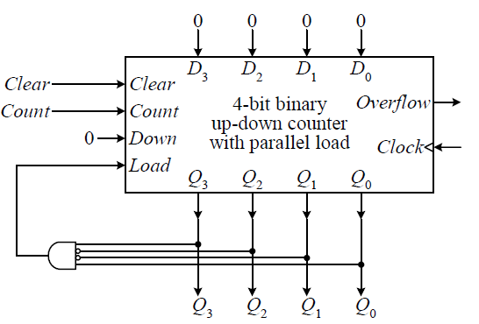
BCD Counter

Slide 30
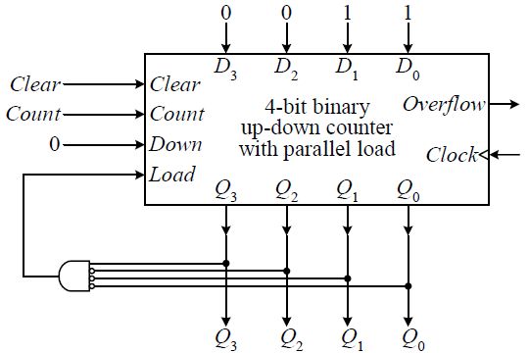
Ex. 4-bit up-down counter that counts from 3 to 8, and back to 3

